Slide 1
Making Home Church into House Churches
South Texas District
Church of the Nazarene
© Matt Price
Professorprice.net
August 2020

Slide 2
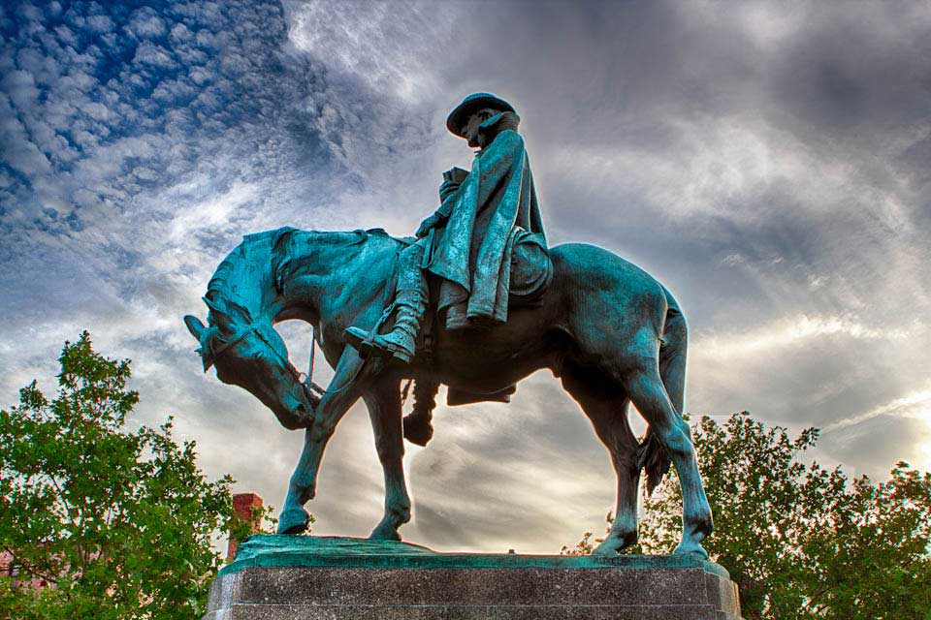
Myths about House Church
We are not really healthy enough.
We don’t have a pastor to do that.
We don’t need another small group.
This doesn’t sound like real church.
http://www.bwcumc.org/news-and-views/to-live-to-god-asbury-in-america/

Slide 3
House Churches Get It Right
Intimacy
Accountability
Freedom/flexibility
Outward-focused
Intentionality
Steve Bremner.com & podcast
https://www.stevebremner.com/2012/04/5-things-the-house-church-movement-is-getting-right/

Slide 4
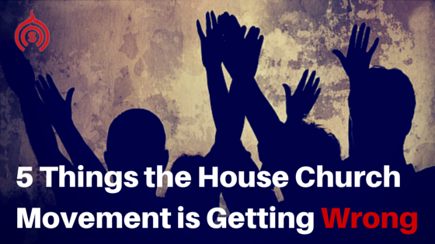
House Churches Get It Wrong
Still needs a space
Inward focused
Not bringing in new people
Not making disciples
Arrogance in being the only way
Steve Bremner.com & podcast
http://stevebremner.com/2012/04/5-things-the-house-church-movement-is-getting-wrong/

Slide 5
House Church, Defined
Acts 2:42-47, NRSV compared to BGS ruling 2015
42 They devoted themselves [meets regularly] to the apostles’ teaching [identified leader] and fellowship, to the breaking of bread and the prayers [spiritual nurture, worship, instruction].

Slide 6
House Church, Defined
Acts 2:42-47, NRSV compared to BGS ruling 2015 43 Awe came upon everyone, because many wonders and signs were being done by the apostles. [Identified leaders]

Slide 7
House Church, Defined
Acts 2:42-47, NRSV compared to BGS ruling 2015
44 All who believed were together and had all things in common; 45 they would sell their possessions and goods and distribute the proceeds to all, as any had need. [aligned with the message and the mission]

Slide 8
House Church, Defined
Acts 2:42-47, NRSV compared to BGS ruling 2015
46 Day by day, as they spent much time together in the temple, they broke bread at home and ate their food with glad and generous hearts, [recognized as a church]

Slide 9
House Church, Defined
Acts 2:42-47, NRSV compared to BGS ruling 2015
47 praising God and having the goodwill of all the people. And day by day the Lord added to their number those who were being saved. [reported as such for district and general church statistics]

Slide 10
House Church, Practiced
Geography matters.
Worship, learn, serve.
Make it local.
At least ten adults.
Find where the Body is,
let the Church go there.
Designate (and train) leaders.

Slide 11
COVID-19 Precautions
No more than ten persons in same room or space
Family groups six feet apart
Children/youth go straight to separate meeting space
Masks recommended/required
Follow local city and state guidelines
Source: cdc.gov (public domain image)

Slide 12
House Church, Practiced
Everyone is a guest;
Honor house rules.
Meeting options:
Concurrent SUN AM
Rebroadcast SUN PM
Another day
Limit time frame.

Slide 13
COVID-19 Precautions
Do not serve food or drinks.
Limit gathering to 45 minutes without need for sharing restrooms
Consider options for group singing: such as reciting hymns, instrumentals, silent prayer, lecito divina (reflective Bible reading)
Source: cdc.gov (public domain image)

Slide 14
House Church, Administered
Designated leaders trained, accountable to, and appointed by local church pastor
Give accurate meeting times and locations
Report participation

Slide 15
House Church, Administered
Offerings best given through online options
Cash/money offerings brought to local church office or picked up by finance team
Announcements given by pastoral staff
Yard signs for all host families

Slide 16
House Church, For Real
Consistent with BGS definition
Includes dynamic truth, nurturing relationships, and active missional presence

Slide 17
House Church, Unified with Local Church
Monthly drive-in option
Weekly social media connection
Written cards sent to every participant
Volunteer opportunities in community
Follow same sermon series

