Slide 1
Servanthood
ICS2042
Cross-cultural Servanthood by Duane Elmer

Slide 2
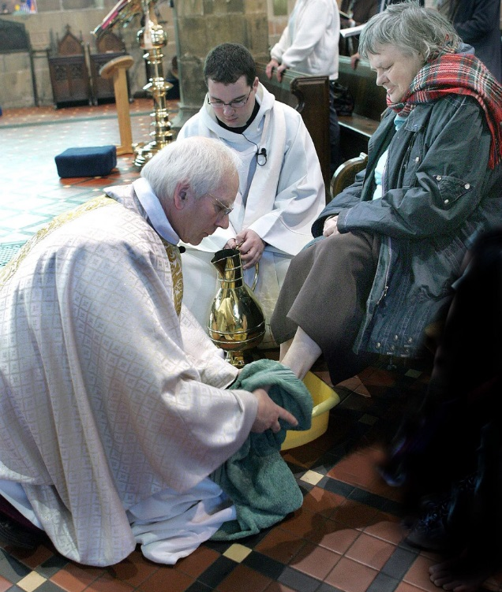
Robe or Towel?
Foot washing by the Bishop of St Asaph, Church in Wales, Maundy Thursday (2007 by Man vyi) CC by 2.0

Slide 3
Robe or Towel?
World → greatness = power over others
God → greatness = service to others

Slide 4
Temptation of Superiority
Superiority cloaked as virtues: p. 17
“It’s not our words that count but the perceptions of local people who watch our lives and sense our attitudes.”

Slide 5
Struggle with Humility
Who is better?
Who has more?
Who is right?
(p. 32)

Slide 6
False Humility
Arrogance
More Knowledgeable
Prideful
Continual conflict

Slide 7
True Humility
“any gracious act offered with no thought of returned favor or desire to announce the good deed.” (p. 30)

Slide 8
True Humility
Not temporary
Not situational
Not training
Not isolated
Not incidental
(p.32)

Slide 9
True Humility
Attitude toward others
Permeates everything
Locally defined
“mutual respect [thru] genuine friendship”
(p.32-33)

Slide 10
Process of Servanthood
Serving after you understand
Understanding after you learn about
Learning after you trust
Trusting after you accept
Accepting after you are open toward others
Opening toward others after taking the posture of humility (instead of superiority)

Slide 11

Openness
Welcomed,
Embraced,
Made to feel safe
In His presence
“Go and do likewise”
Delicate Arch at sunset, Arches National Park (2005) CC by-sa 3.0

Slide 12
Openness
Hospitality
“hostel”
Taking in the stranger
Honor others by allowing them to welcome us

Slide 13

Categorize
Pixabay.com cc0 public domain
“Like” or “dislike”
Humans make unconscious decision to categorize on physical appearance: less than 5 seconds to find out if someone is worthy of relationship

Slide 14
Skills for Openness
Suspending judgment: questions to assess
Ambiguity
Thinking gray (get all info before judging)
Positive attribution: assume the best
(pp. 50-55)

